Slide 1
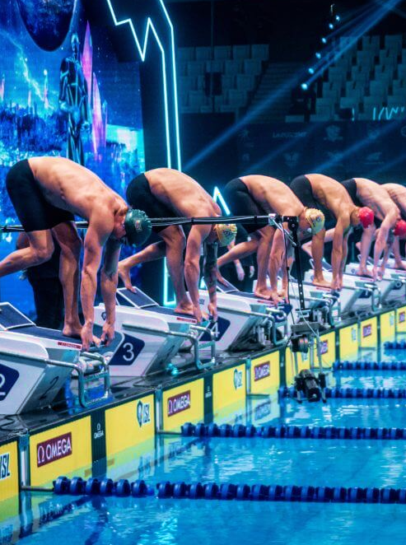



Fatigue Monitoring & Injury Prevention in Elite Swimmers
Legenda tabelas feito no ppt
Ver se treinos e testes nao estao trocados
Hugo Veríssimo 124348
João Cardoso 50750
Foundations of Machine Learning 24/25

Slide 2
cONTENTS
Project Overview
Data Analysis
Machine Learning models
Results
Conclusions

Slide 3
Project Overview

Slide 4
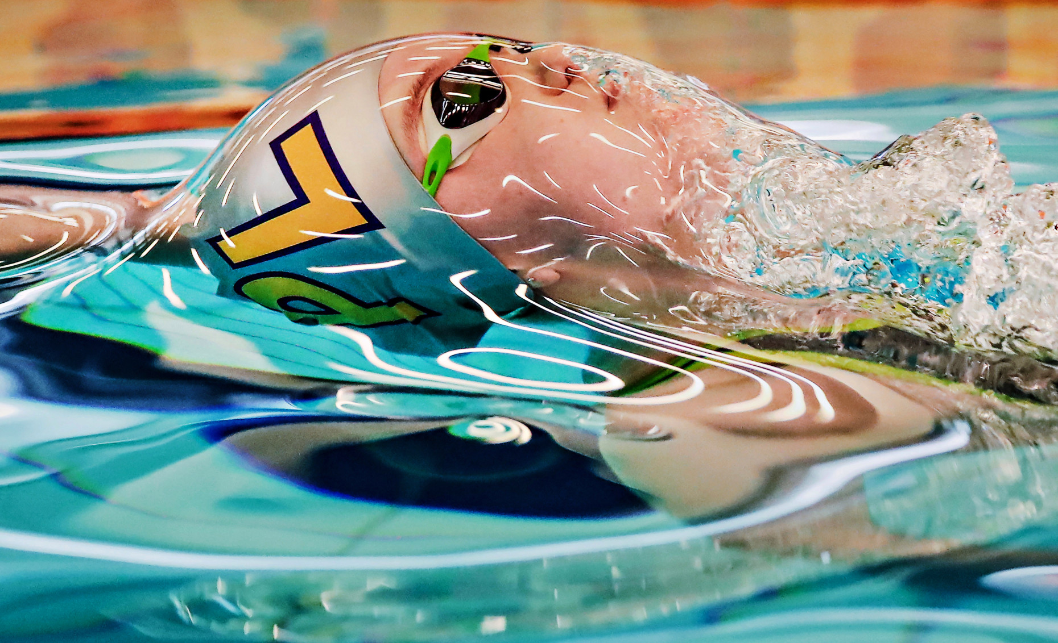
The ProbleM
Improving performance of elite athletes is the ultimate goal of any sports coach.
Balance between workload and rest is crucial.
Too high effort, may lead to injury, too low and some gains may be left on the table.

Slide 5
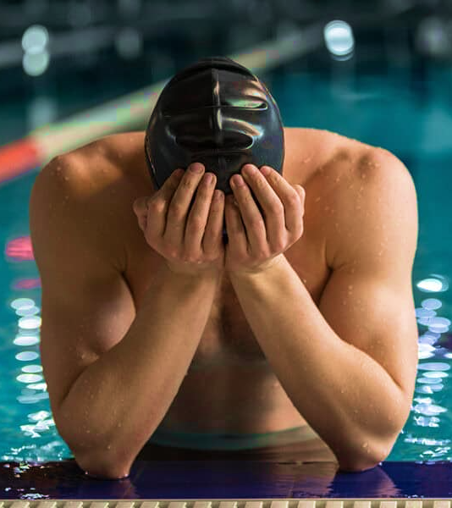
State of the Art
Fatigue and injury prediction using ML models, such as Logistic Regression, Random Forest, Support Vector Machine, among others, across different sports contexts.
Feature engineering and selection is among the most debated topics.
Overfitting problems.

Slide 6

Methodology
Raw Data
Data Assessment
Data Normalization
Train Multiple ML Models
Model Evaluation
Deploy Best Model
Logistic Regression
Support Vector Machine
Decision Tree
StandardScaler
Recall
F1-Score
Accuracy
Learning Curve
Confusion Matrix
Precision
train_test_split
RandomizedSearchCV

Slide 7
Data Analysis

Slide 8
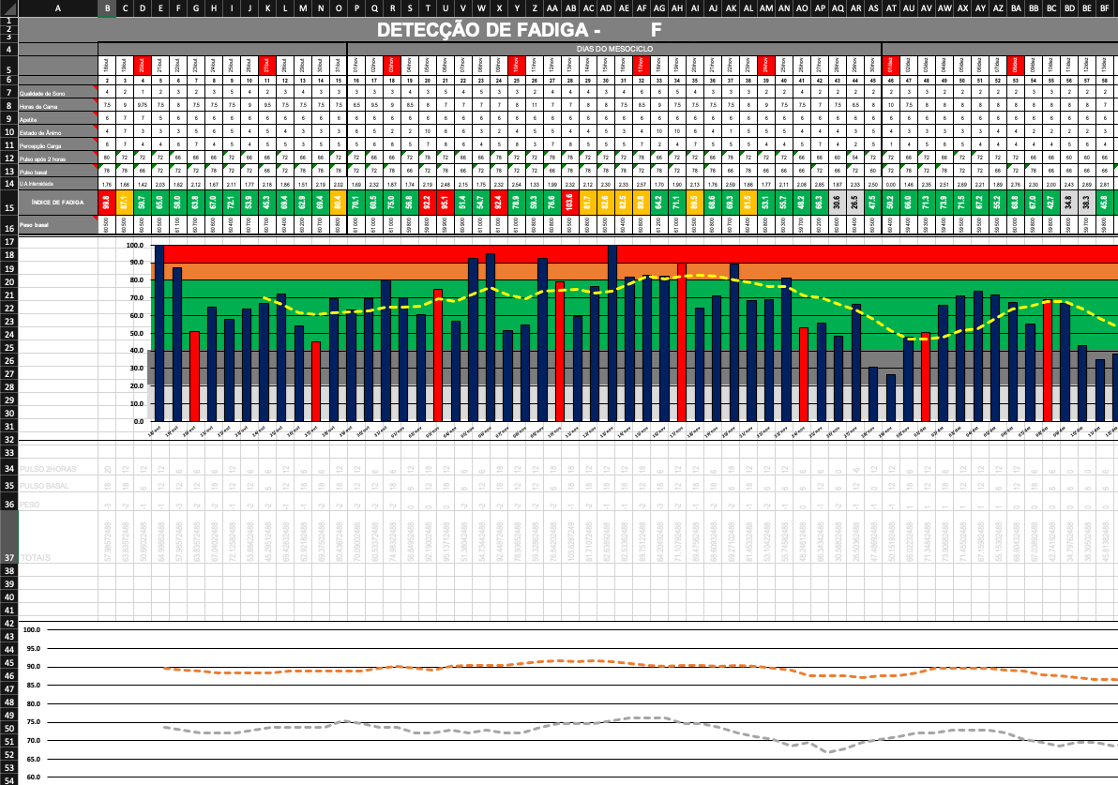
RAW DATA
Swimming club CAPGE
Season 2019/2020
7 athletes
11 different metrics
Around 200 obs. per athlete

Slide 9
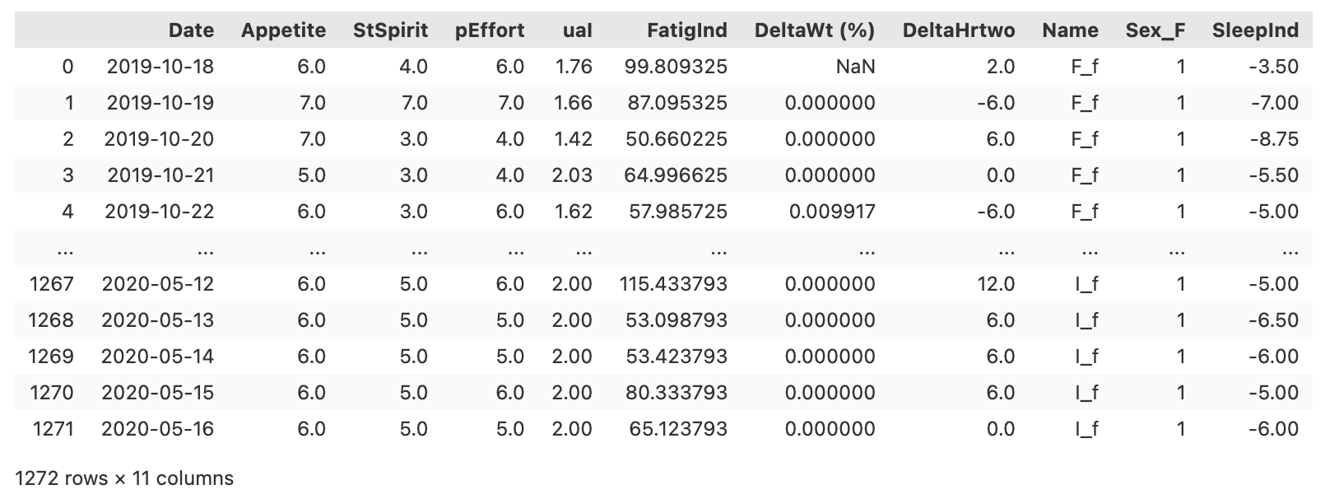
structured data

Slide 10
Feature engineering

Slide 11
Overcoming Data Challenges
SMOTE and random undersampling
Random oversampling and undersampling

Slide 12
Feature Selection

Slide 13
Machine learning models

Slide 14
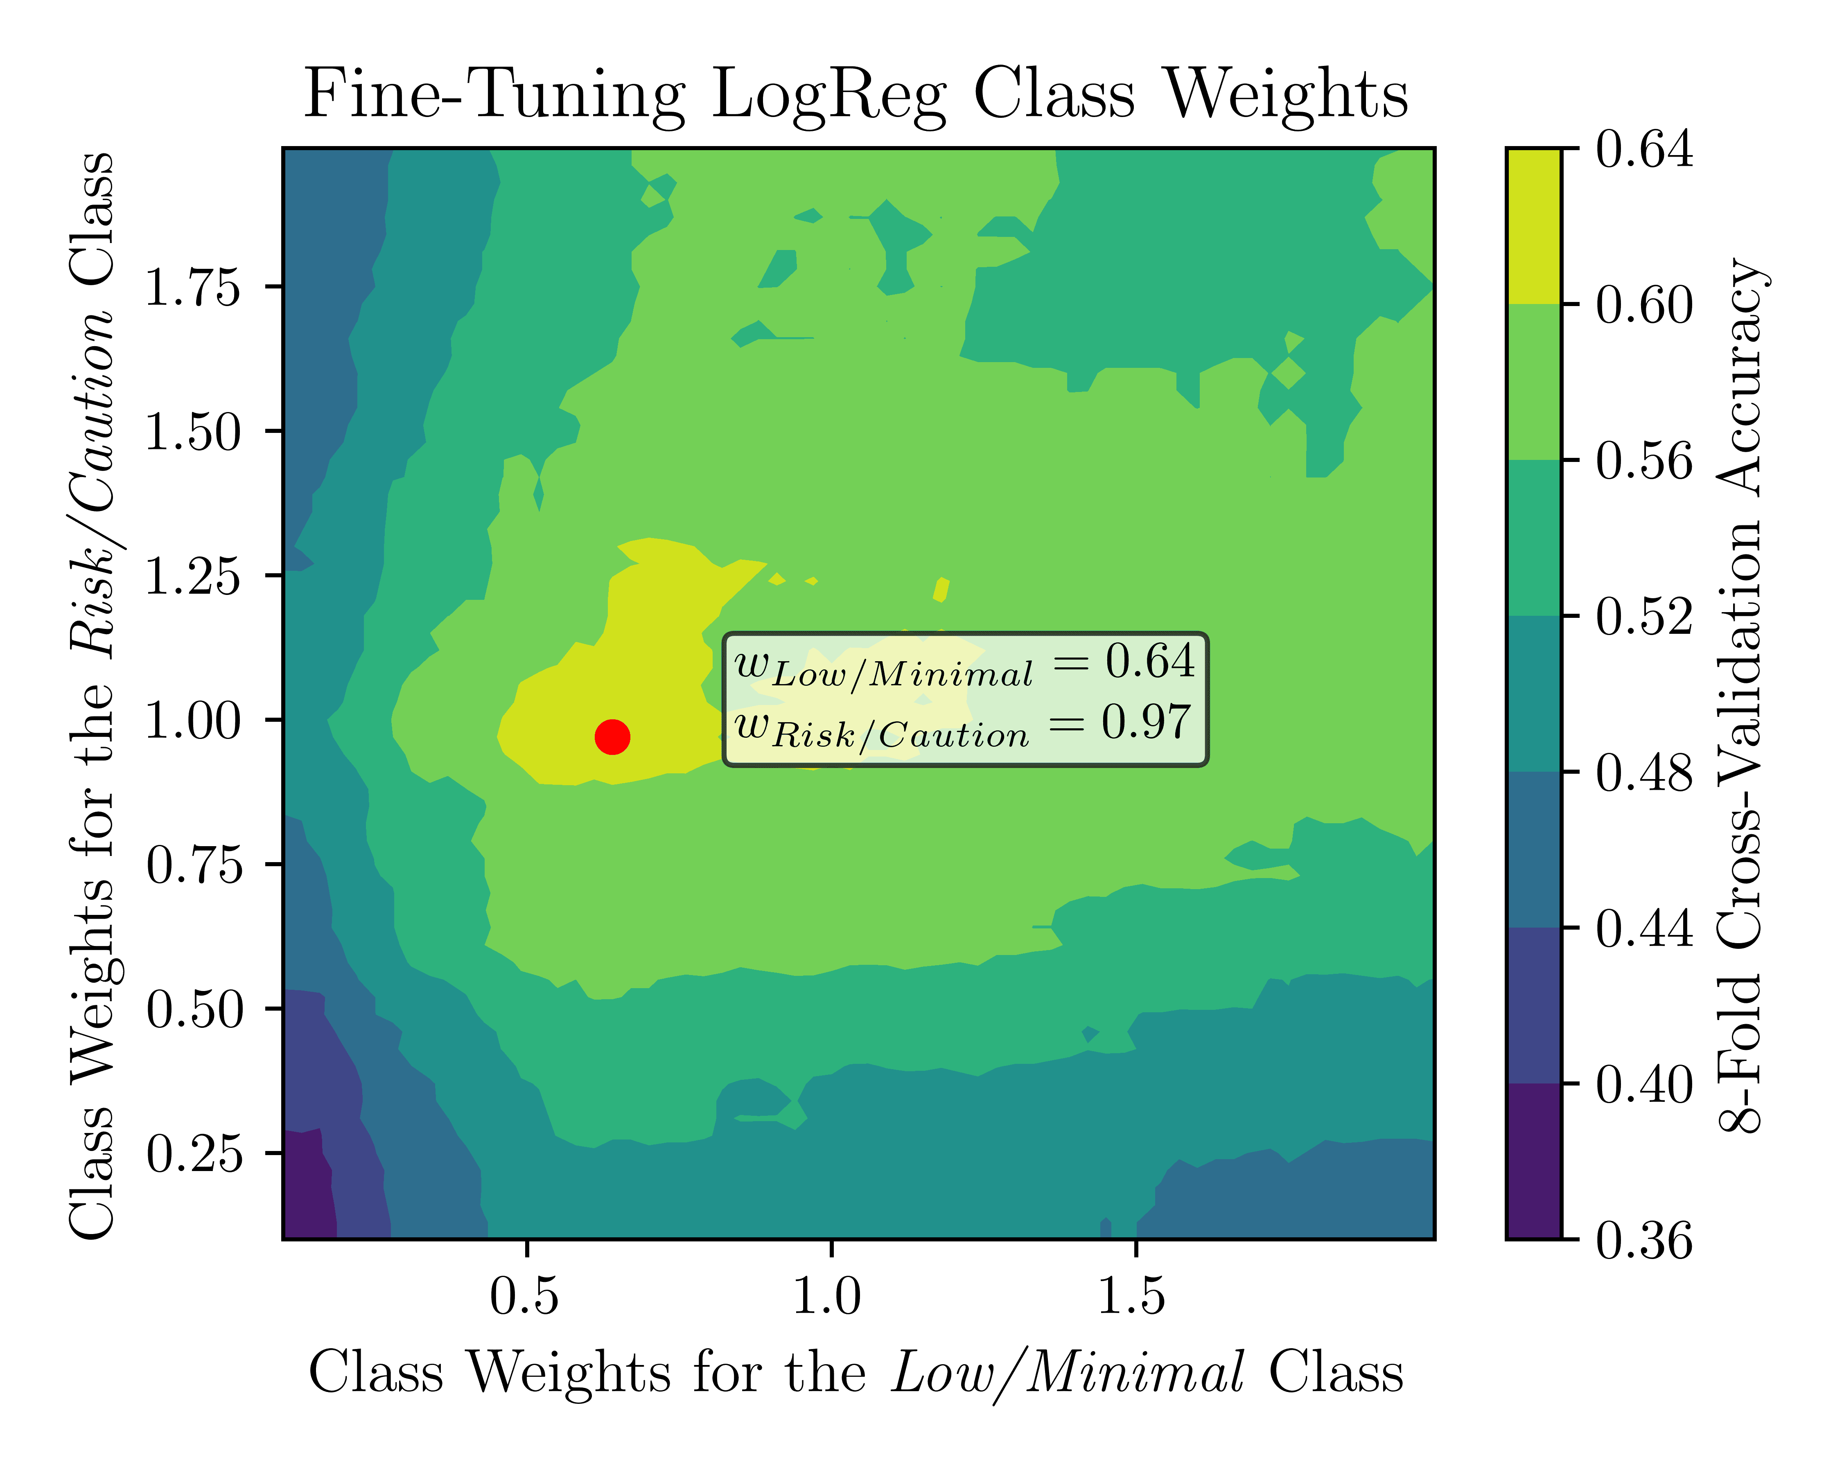
LOGISTIC REGRESSION

Slide 15
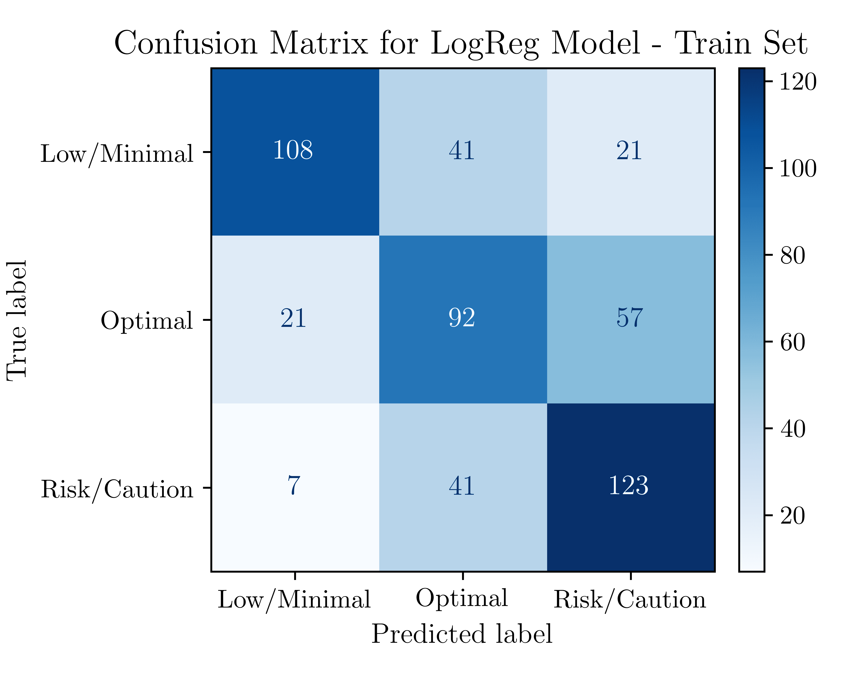
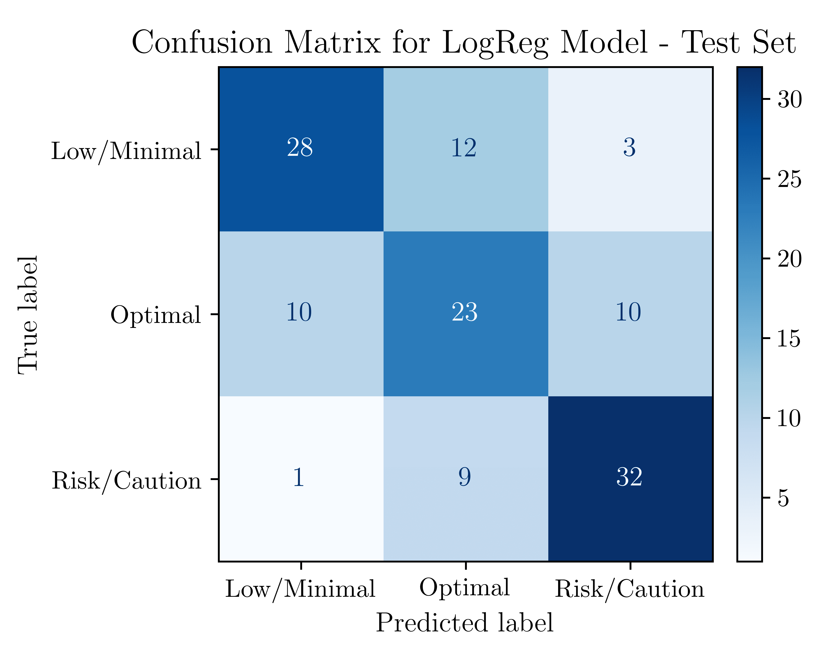
logreg: RESULTS

Slide 16
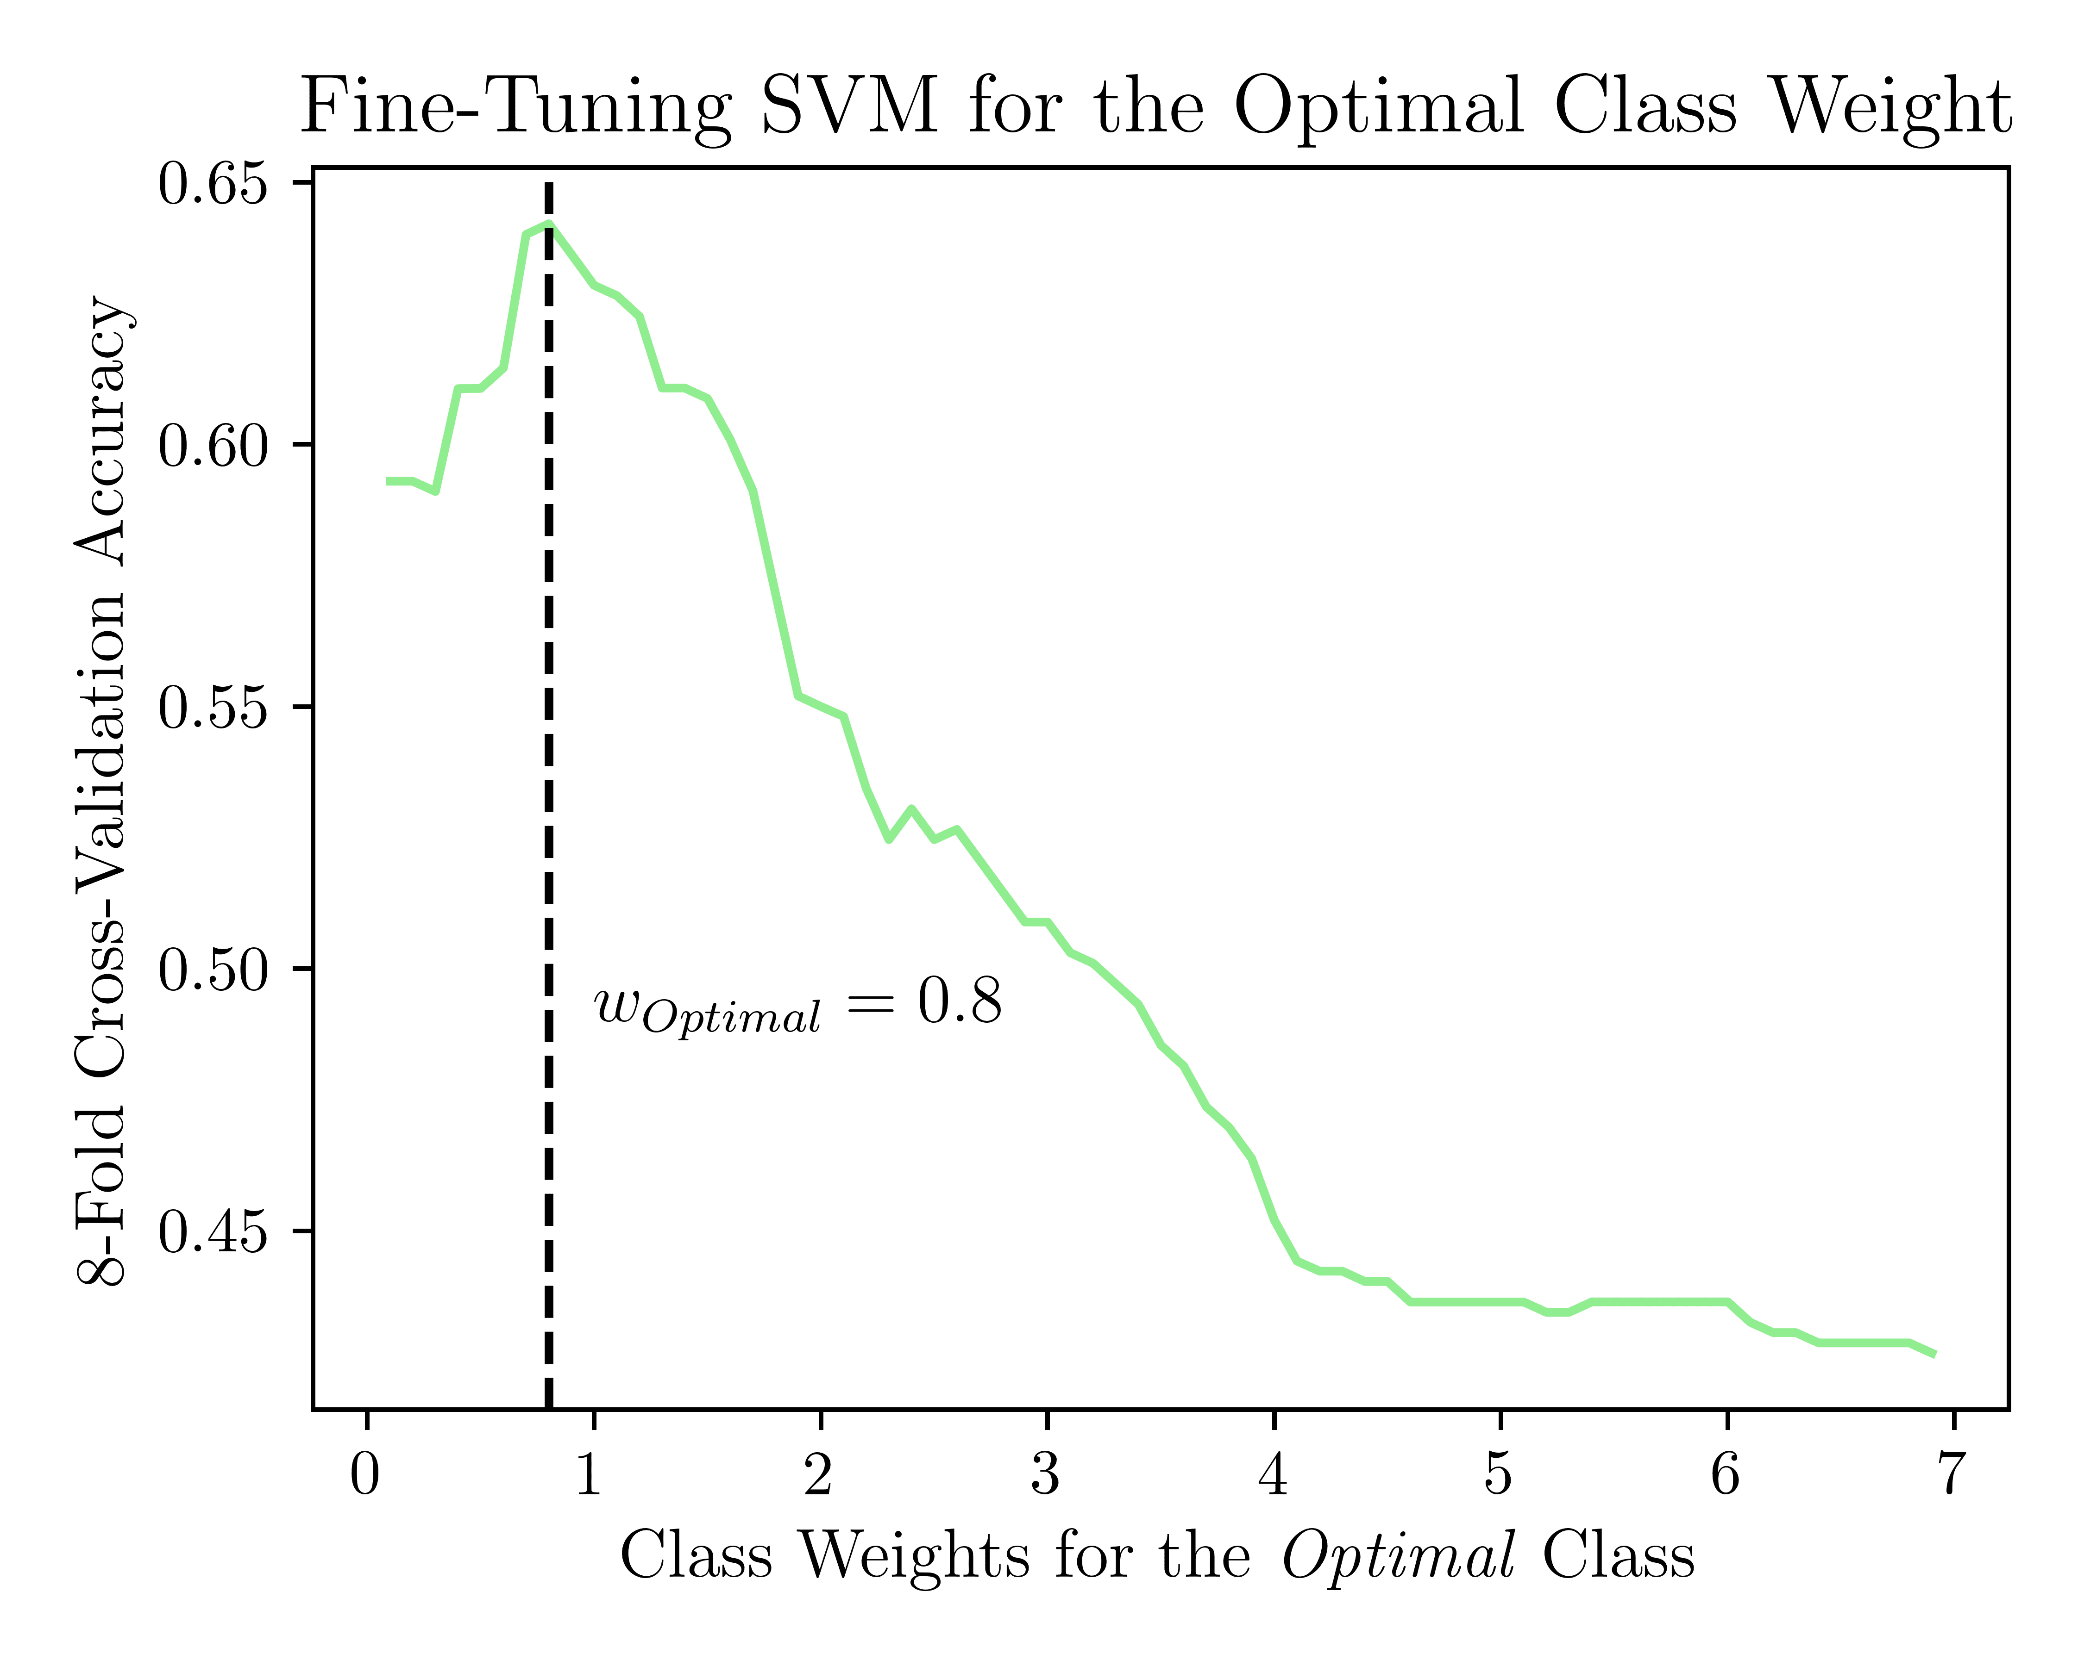
Support vector machine

Slide 17
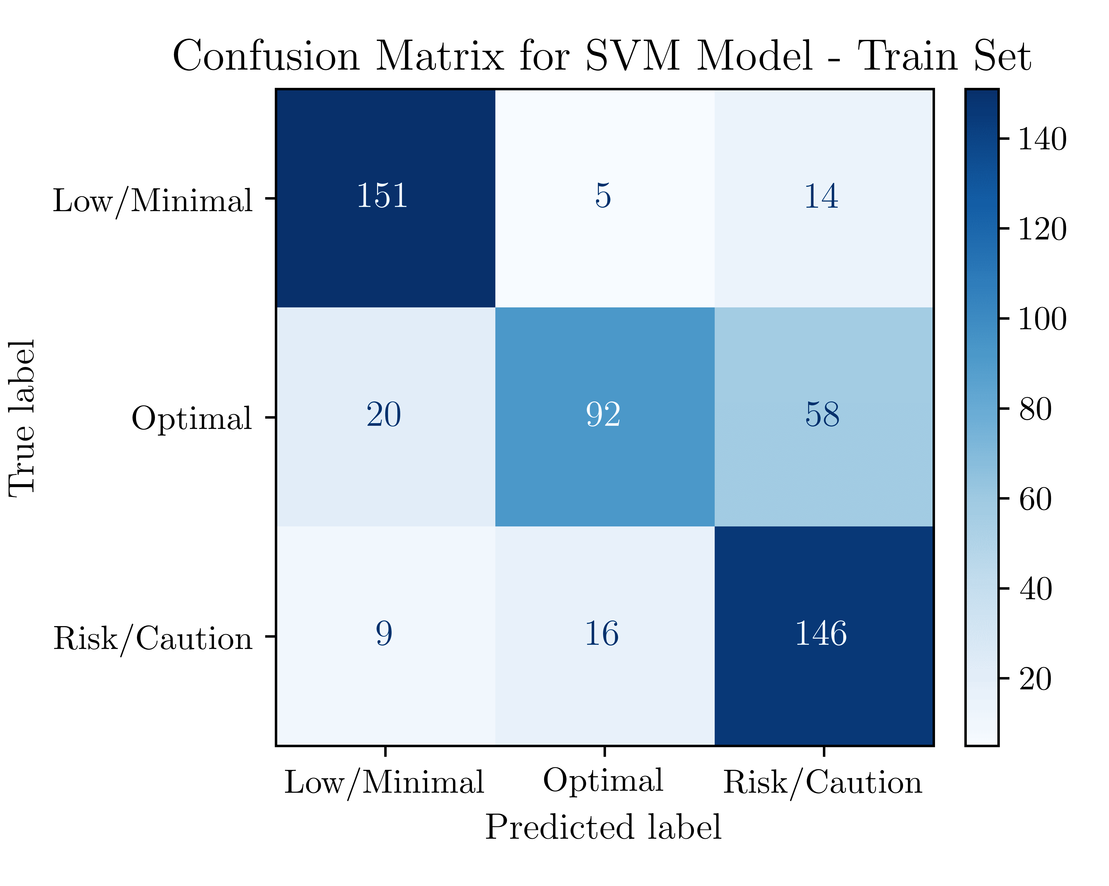
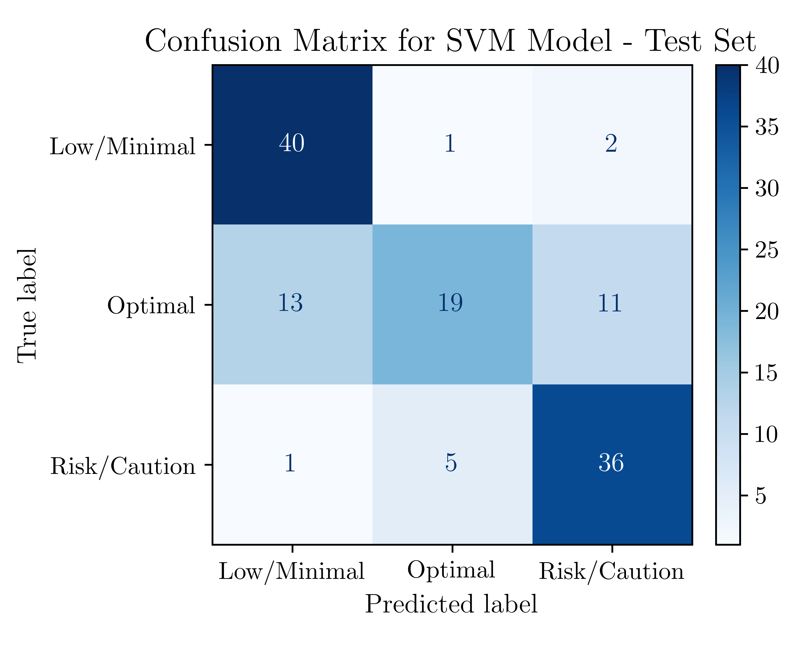
SVM: RESULTS

Slide 18
decision tree

Slide 19
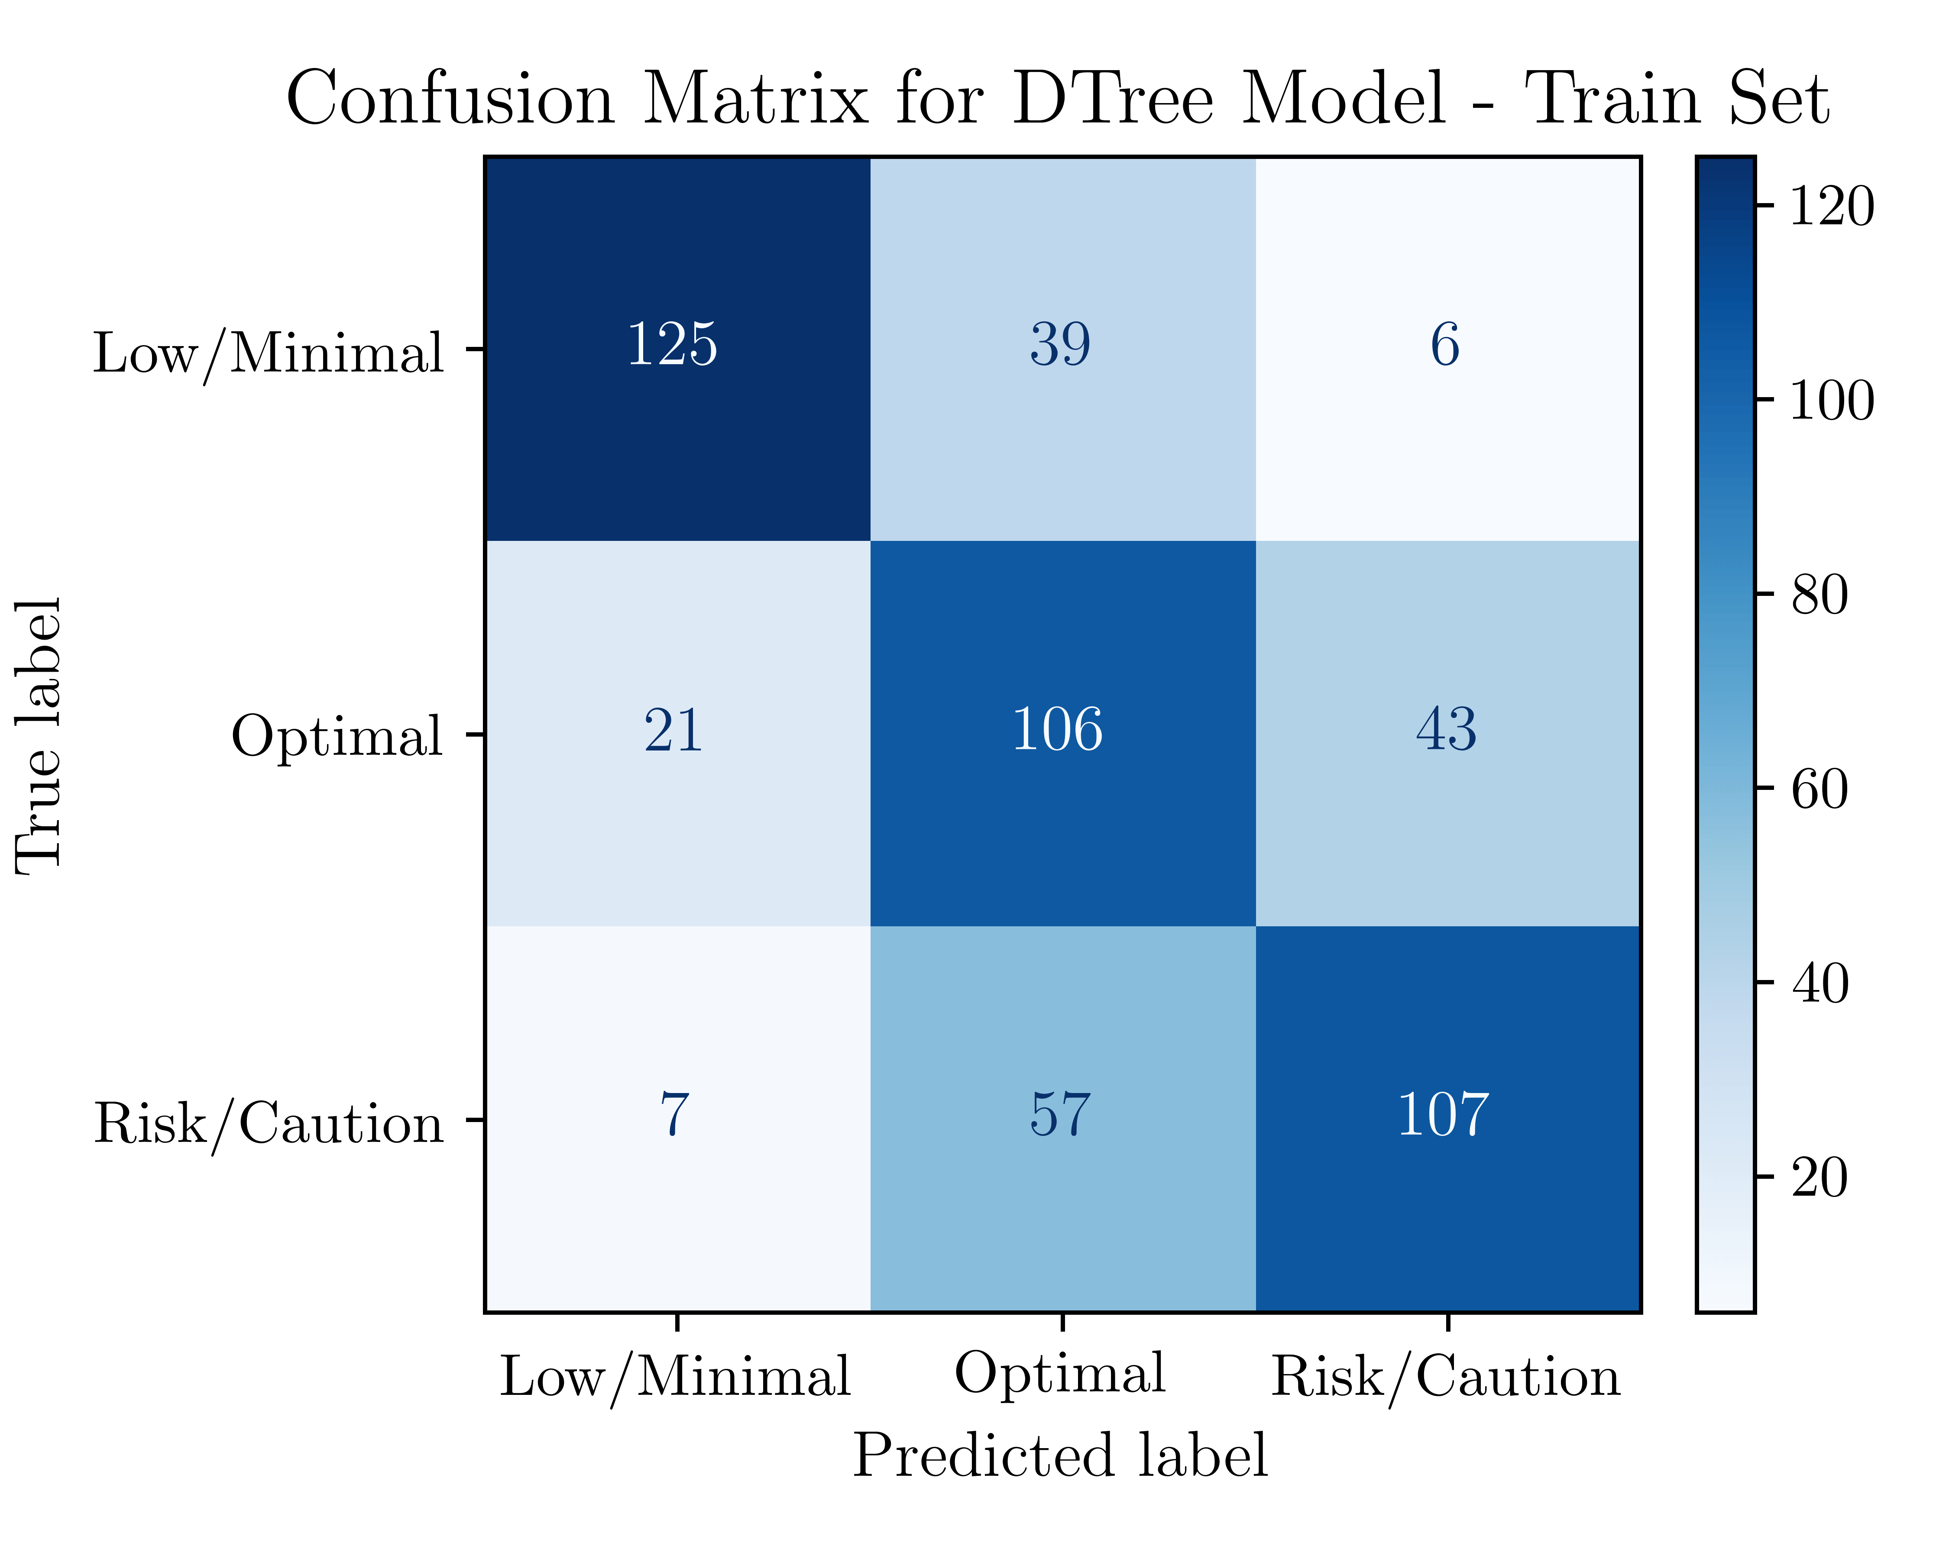
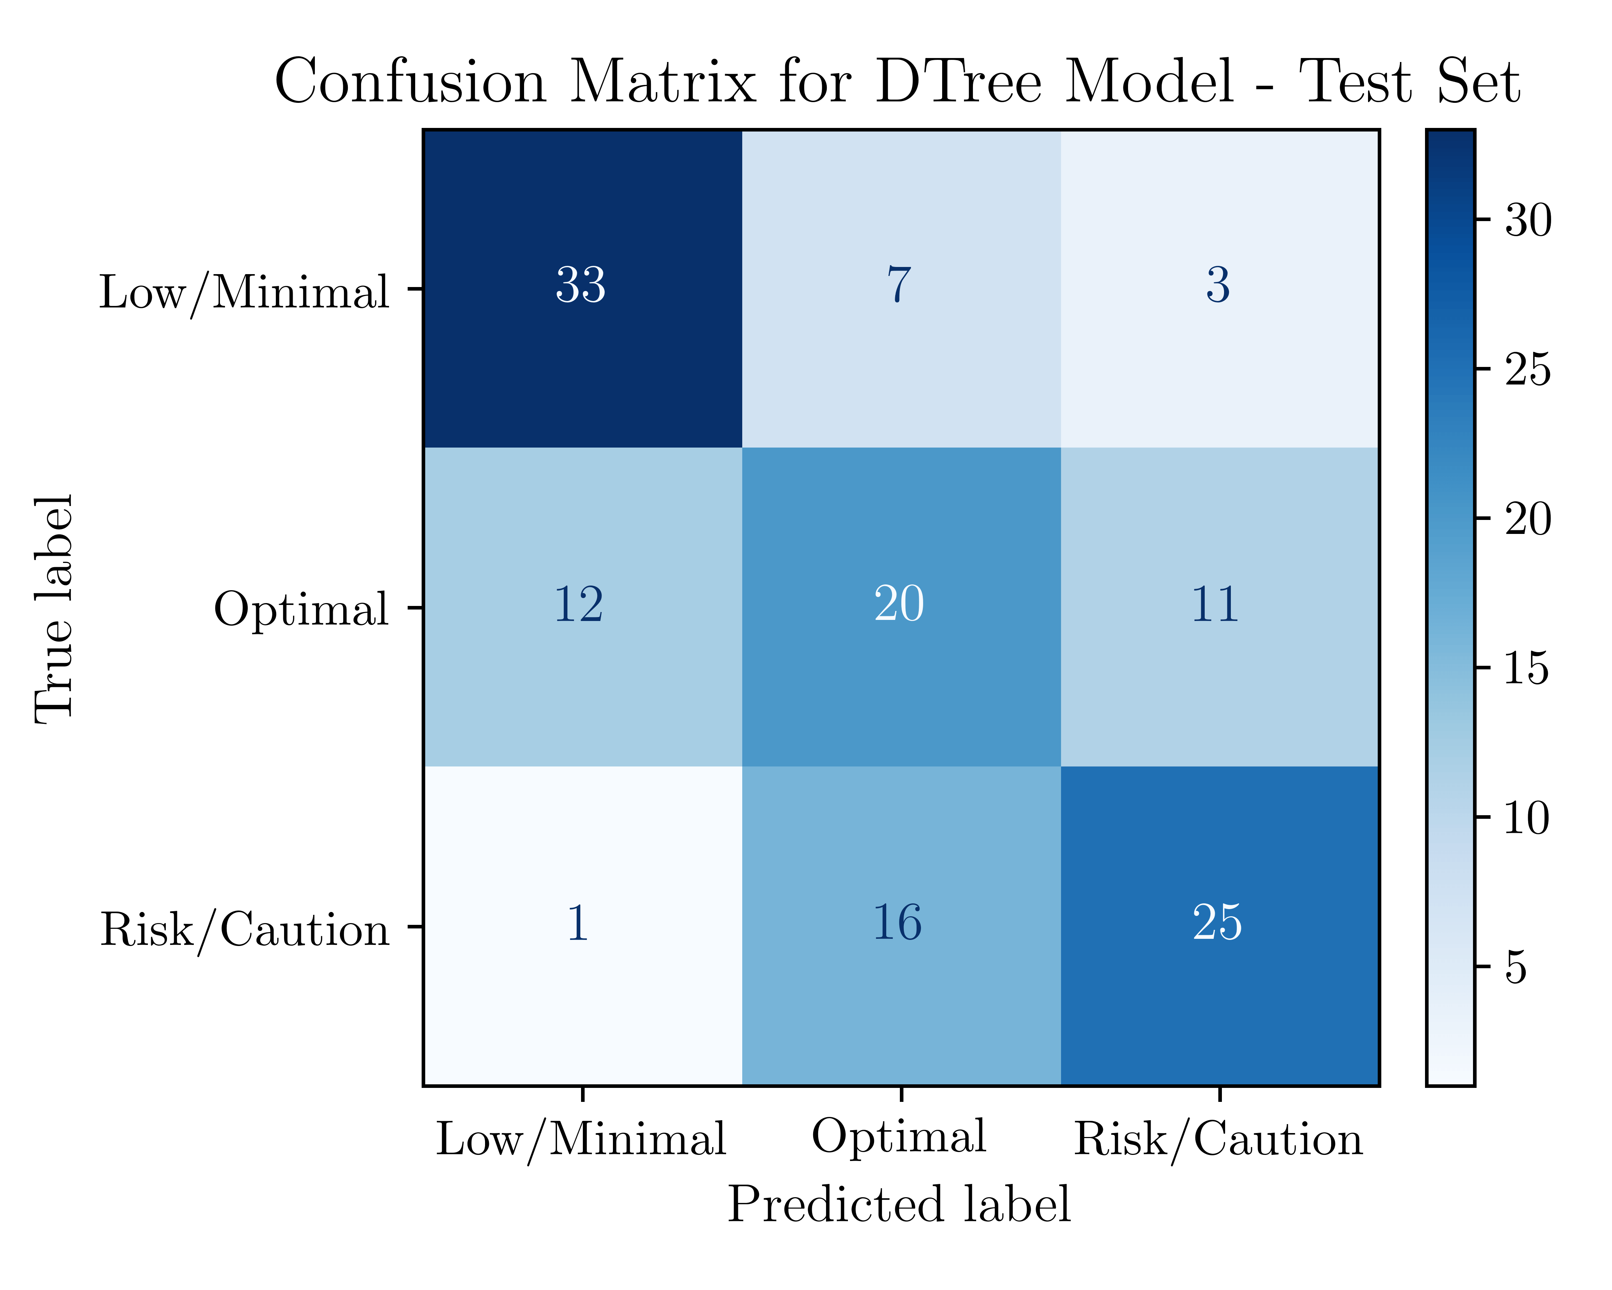
Dtree: RESULTS

Slide 20
Results

Slide 21
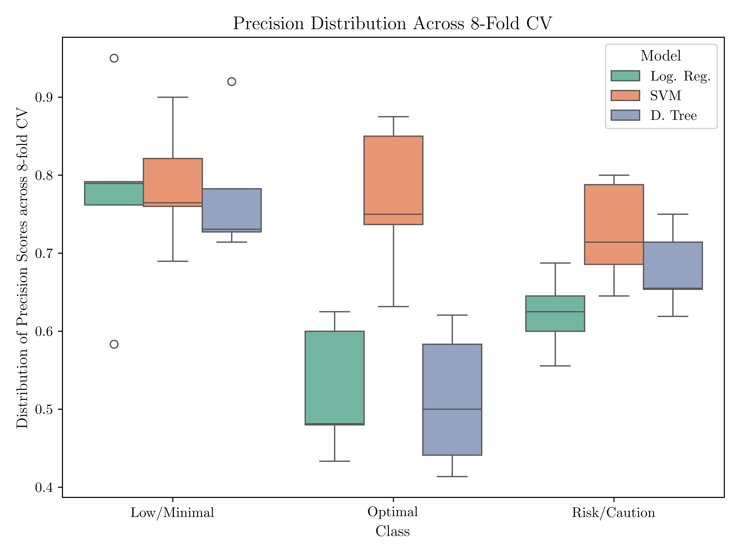
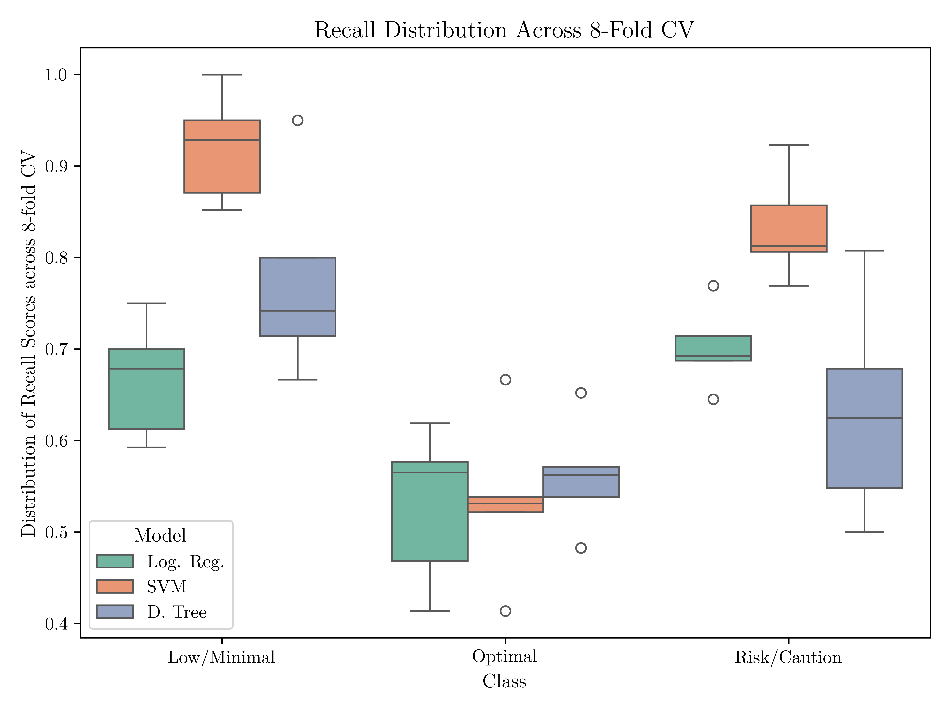
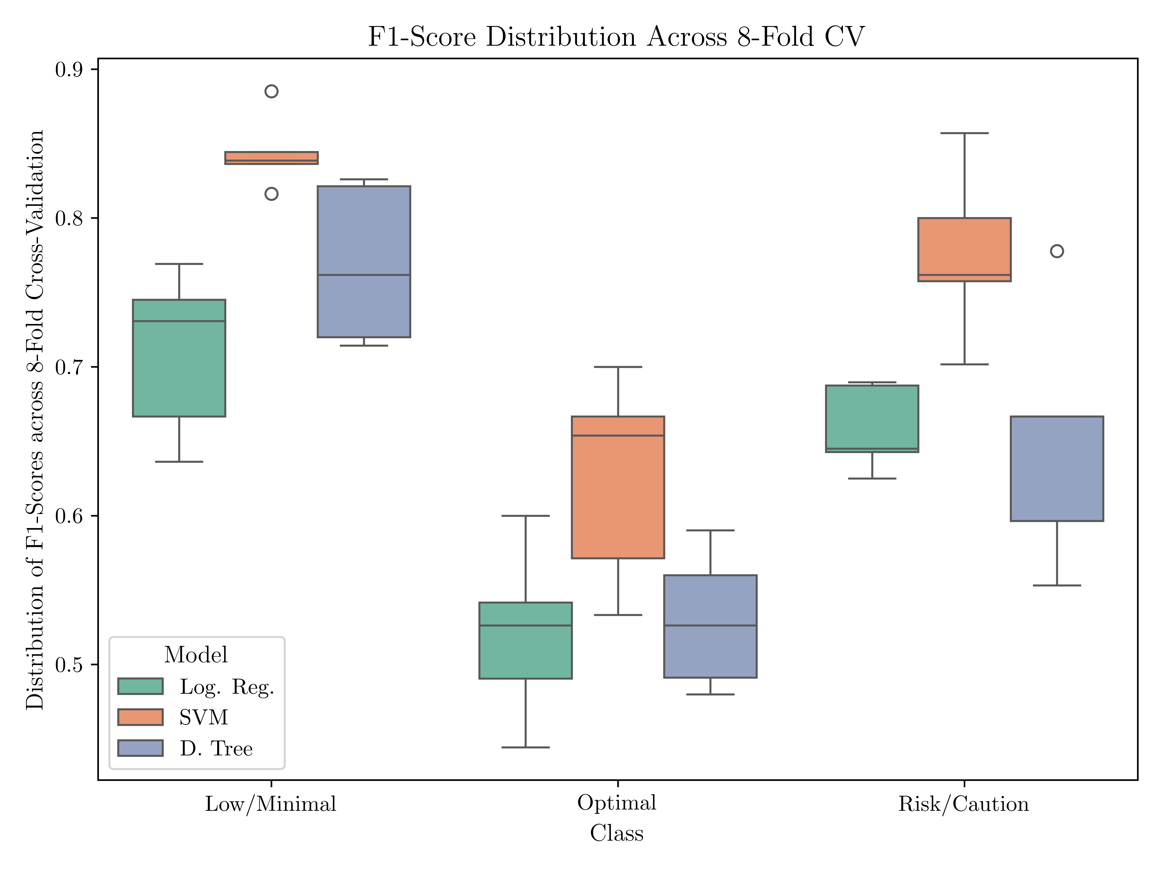
Performance Metrics

Slide 22
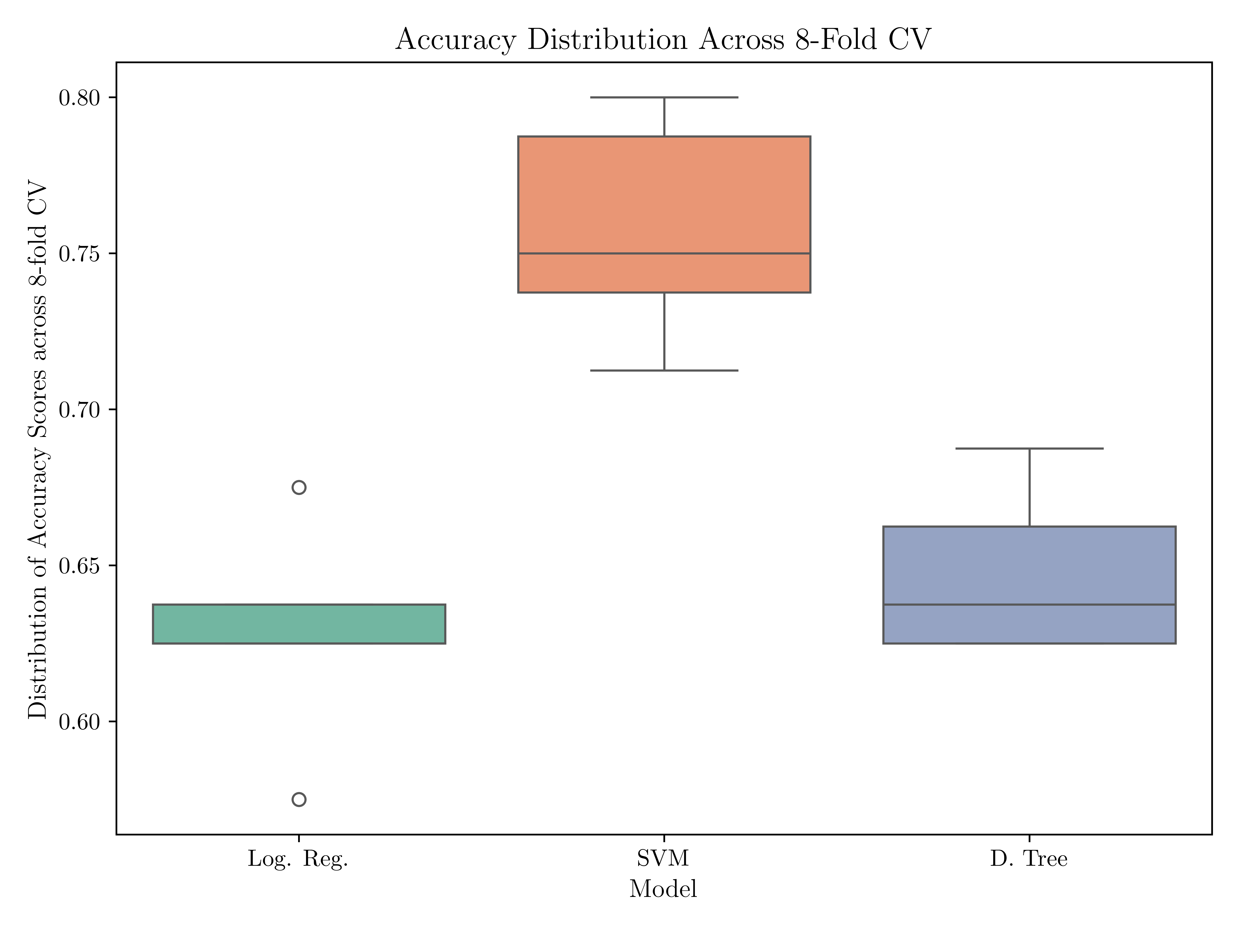
Performance Metrics

Slide 23
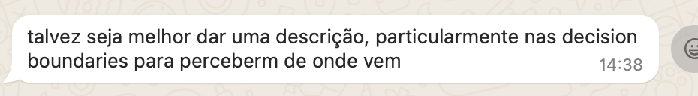
Decision Boundaries

Slide 24
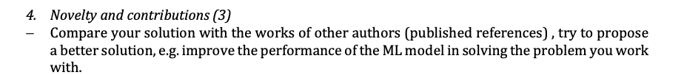
Literature Benchmark
Comparacao a literatura

Slide 25
Conclusions

